Slide 2
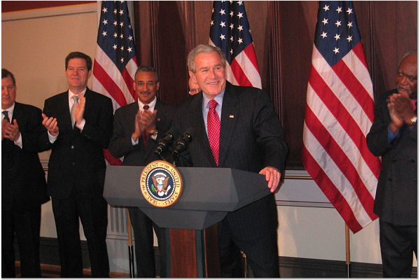
Landmark Federal Legislation: Second Chance Act

Slide 3
Objectives  Provide a one-stop, interactive source of current, user-friendly
reentry information.
■ Identify, document, and promote evidence-based practices.
■ Deliver individualized, targeted technical assistance to the Second
Chance Act grantees.
■ Advance the reentry field through training, distance learning, and
knowledge development.

Slide 4
Approach  Broad-based distance learning resources available through our website  Targeted, individualized assistance to SCA grantees

Slide 5
Extensive Collaboration

Slide 6
Organizational Structure
Steering Committee
CSG Justice Center, BJA, APPA, ASCA, Shay Bilchik
Advisory Council
Housing Committee
Juvenile Justice
Committee
Health, Mental Health, Substance Abuse
Committee
Tribal Affairs
Committee
Victims & Survivors
Committee
Employment &Education
Committee
Local Government
Committee
Pre-Release Planning & Post-Release Supervision
Committee
Communities & Families
Committee

Slide 7
Broad-based TA for the field: Website www.nationalreentryresourcecenter.org

Slide 8
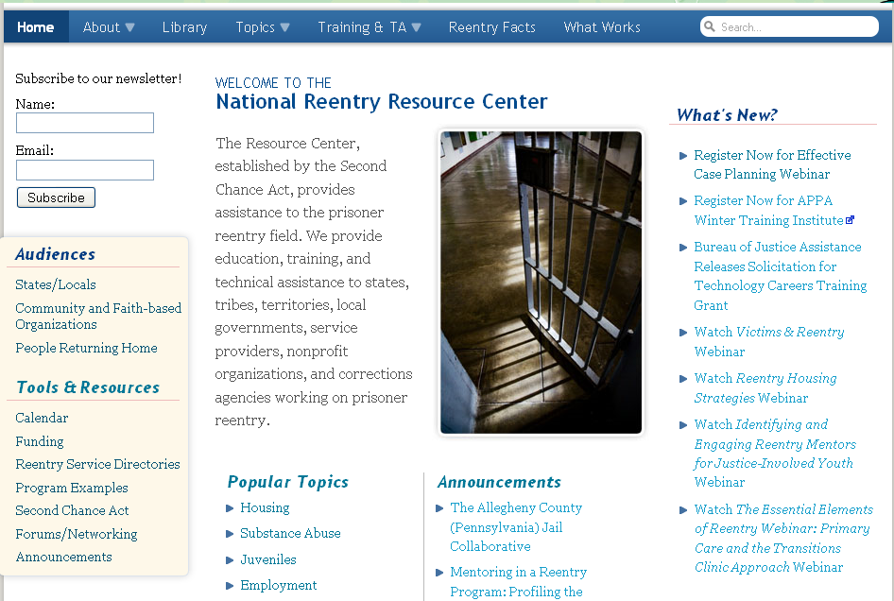
www.nationalreentryresourcecenter.org

Slide 9
Topics Pages

Slide 10
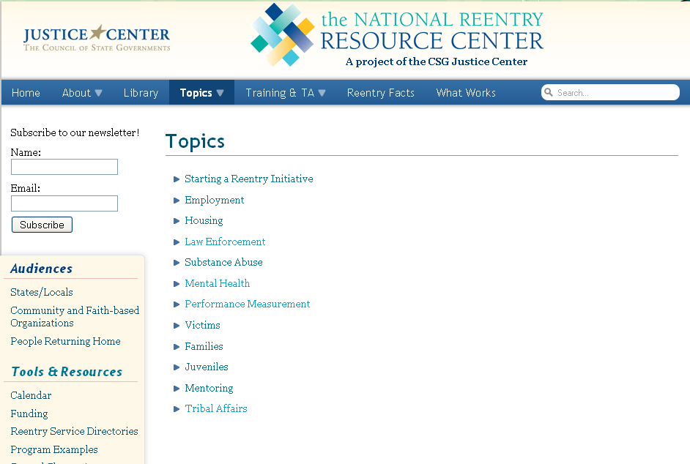
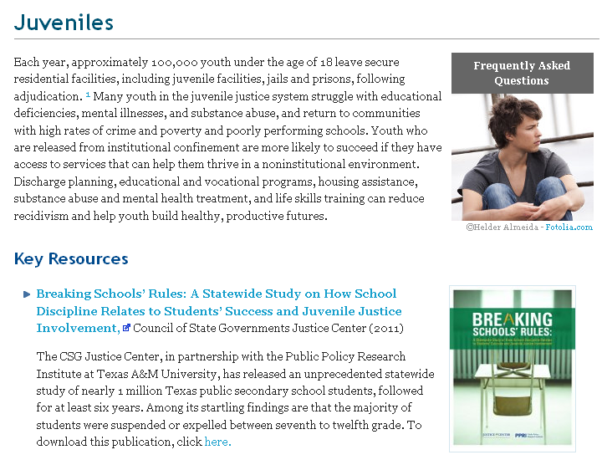
Topics Pages

Slide 11
Frequently Asked Questions

Slide 12
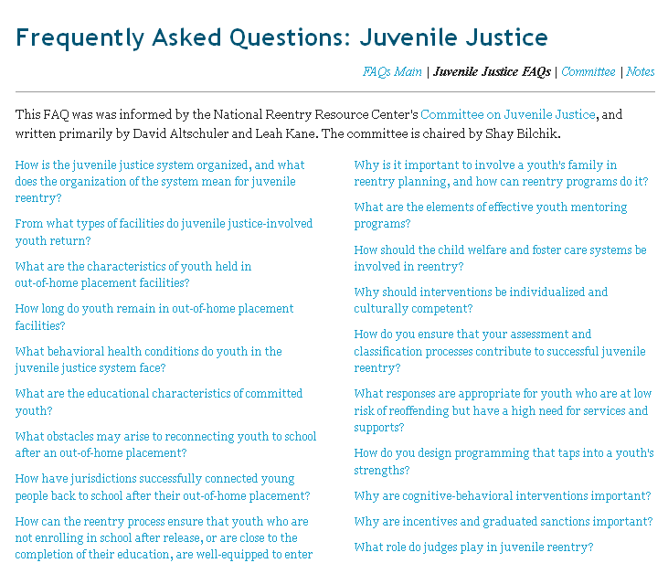

Slide 13
Interactive Map of National Criminal Justice Initiatives

Slide 14
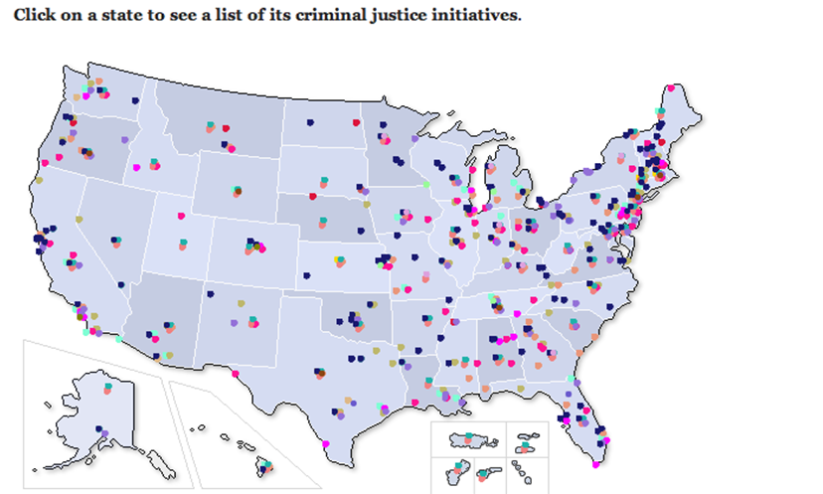
Interactive National Criminal Justice Initiatives Map
Users can view initiatives by state or by program by clicking on different sections of the map.

Slide 15
Webinars

Slide 16
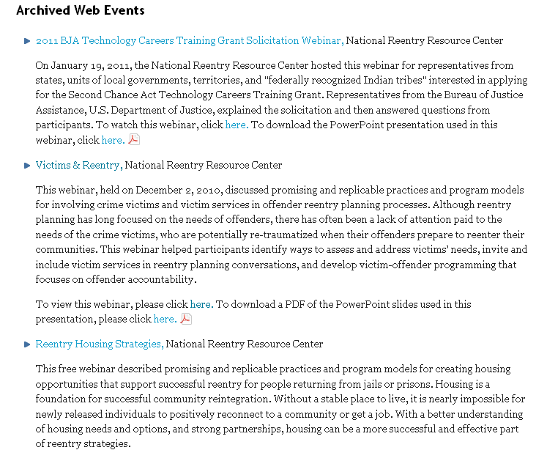

Slide 17
Webcasts/Podcasts

Slide 18
Webcasts/Podcasts

Slide 19
Newsletter

Slide 20
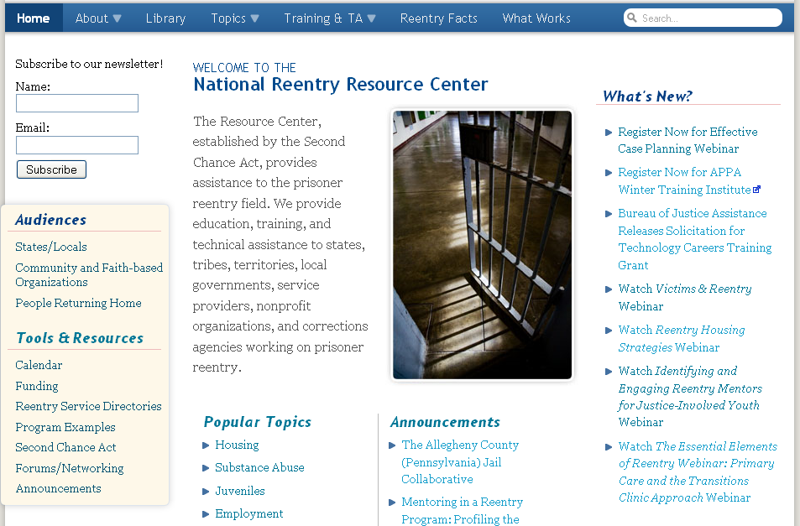
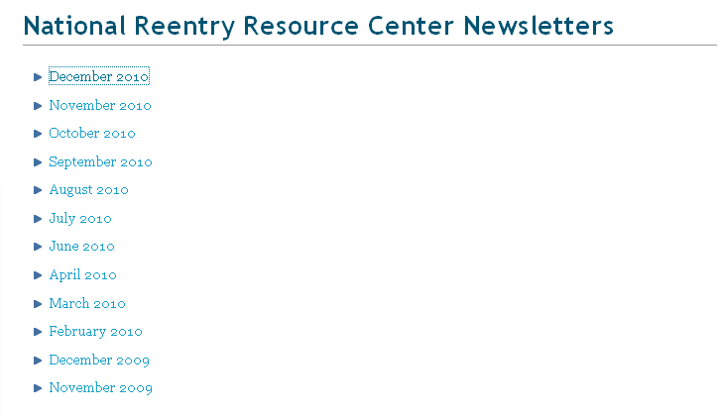
Newsletter

Slide 21
National Training Event for SCA Grantees

Slide 22
Session Overviews
Handouts and Powerpoint Presentations
Conference Session Videos

Slide 23
Targeted, Individualized TA

Slide 24
Focus on Risk Reduction

Slide 25
■ Focus on youth at a higher risk for reoffending
■ Match services and supports to the needs that will reduce risk
■ Enhance each youth’s ability to learn new skills and attitudes

Slide 26
■ Collaborative, comprehensive system planning
■ Evidence-based program design
■ Learning from the research, learning from each other

Slide 27
For more information about the National Reentry Resource Center or the Second Chance Act, please visit our website: http://www.nationalreentryresourcecenter.org/ Or contact: Le’Ann Duran (240) 482-8585 info@nationalreentryresourcecenter.org

